Slide 1
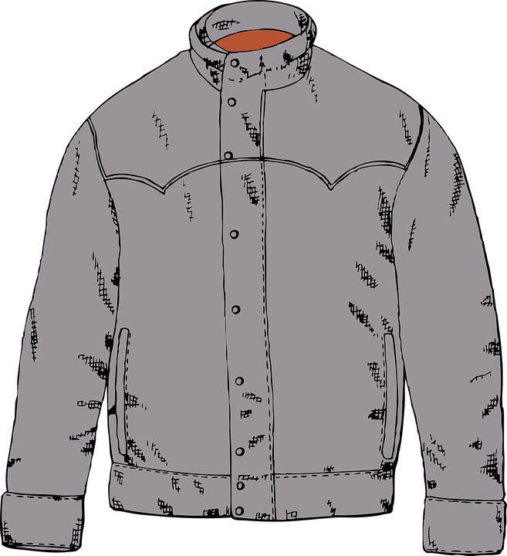
Describing
This is in the context of percentages and money.
Ben has saved £200. He spends £65 on a jacket and £45 on some trainers. Ben says, “I have spent 55% of my money.”
Is he correct? Explain your reasoning.
The numbers I need to use first are £65 and £45.

Slide 2
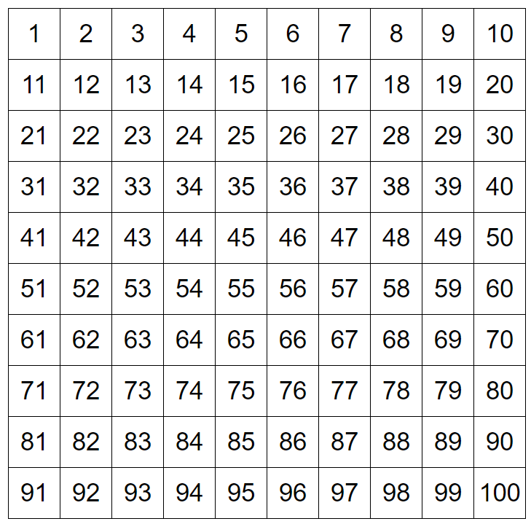
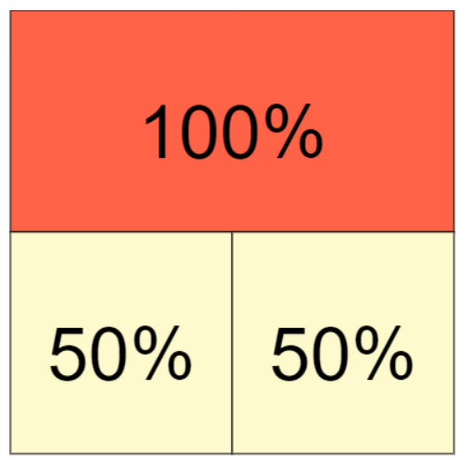
Explaining
I know that 100% = £200 because that is the total amount Ben had at the start.
Ben has saved £200. He spends £65 on a jacket and £45 on some trainers. Ben says, “I have spent 55% of my money.”
Is he correct? Explain your reasoning.
It is true that 50% = £100
Recall of knowledge
Finding 50% is the same as halving.
Recall of knowledge

Slide 3
Convincing
I am convinced that £65 + £45 is more than 50%.
I can prove that 50% = £100 and 10% = £20, so 5% = £10
Ben has saved £200. He spends £65 on a jacket and £45 on some trainers. Ben says, “I have spent 55% of my money.”
Is he correct? Explain your reasoning.
£200
Recall of knowledge
Finding 50% is the same as halving.
Recall of knowledge
Finding 10% is the same as ÷ 10.
Recall of knowledge
Finding 5% is the same as ÷ 10 ÷ 2
£100
£20
£10

Slide 4
Justifying
50% = £100
10% = £20
5% = £10
Ben has saved £200. He spends £65 on a jacket and £45 on some trainers. Ben says, “I have spent 55% of my money.”
Is he correct? Explain your reasoning.
Ben spent £110, so 50% + 5% = £100 + £10
Recall of knowledge
Finding 50% is the same as halving.
Recall of knowledge
Finding 5% is the same as ÷ 10 ÷ 2

Slide 5
Expert
Ben is correct. He spent £110, which is 50% + 5% = £100 + £10.
Specialising
Ben has saved £200. He spends £65 on a jacket and £45 on some trainers. Ben says, “I have spent 55% of my money.”
Is he correct? Explain your reasoning.
Examples that satisfy the statement.
60% of £400 is £240 as 50% = £200, 10% = £40
75% of 700m is 525m as 50% = 350m, 25% = 175m
To find % amounts greater than 50% it is always better to find half of the amount first.
Generalising

Slide 6
Conjecturing
When calculating % is it always best to find 50% first of the amount given, finding half.
Conjecturing: reasoning about mathematical relationships to develop statements that are tentatively thought to be true but are not known to be true (Lannin, Ellis & Elliott, 2011)

Slide 7
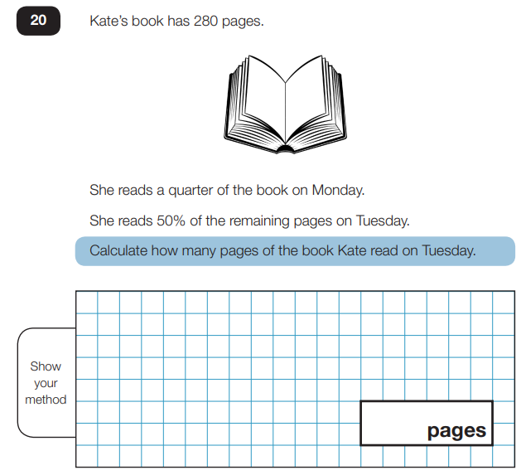

Slide 8
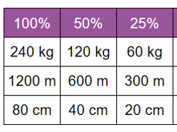
When calculating % is it always best to find 50% first of the amount given, finding half.
Offering proof that it is sometimes true
Complete the table
120 kg
Offering proof that it is true
What arithmetic is required to find 25%?

Slide 9
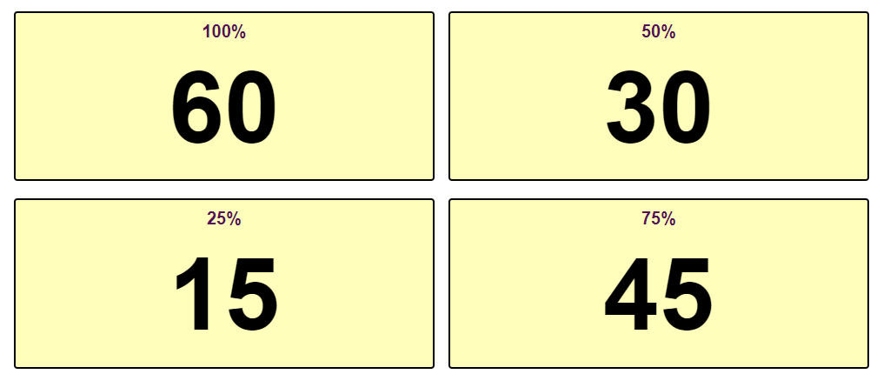
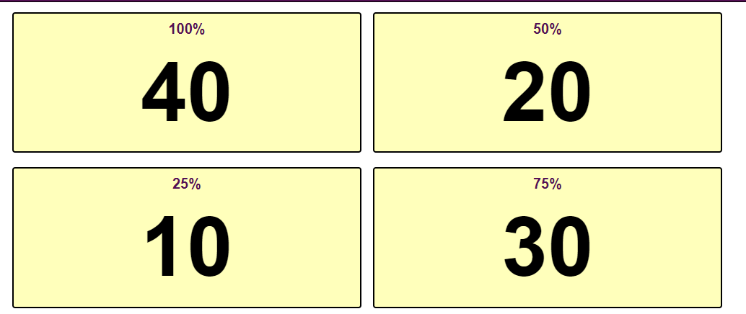
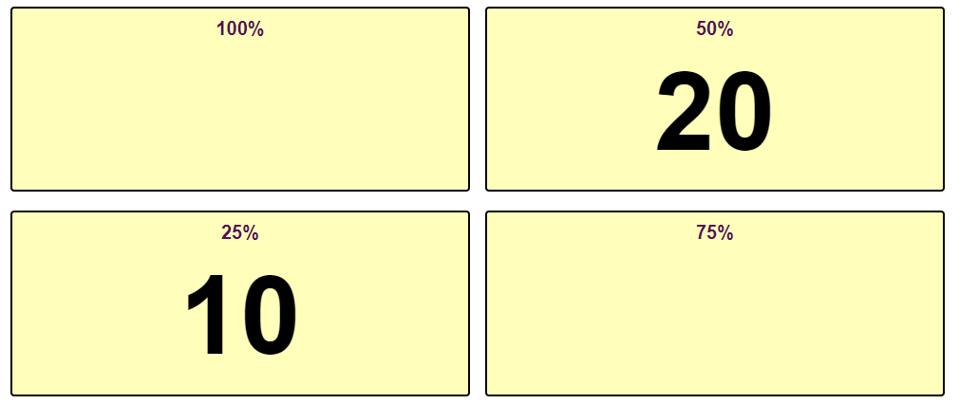
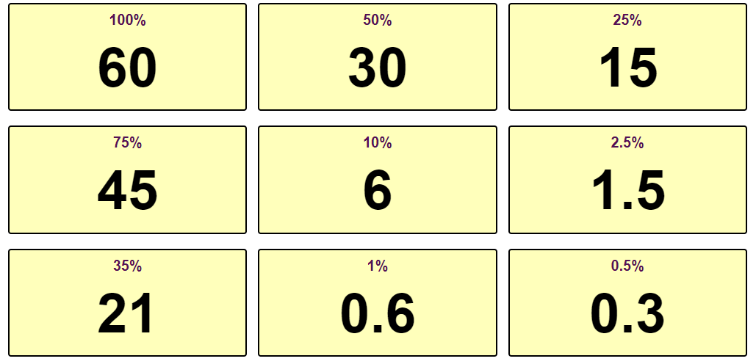
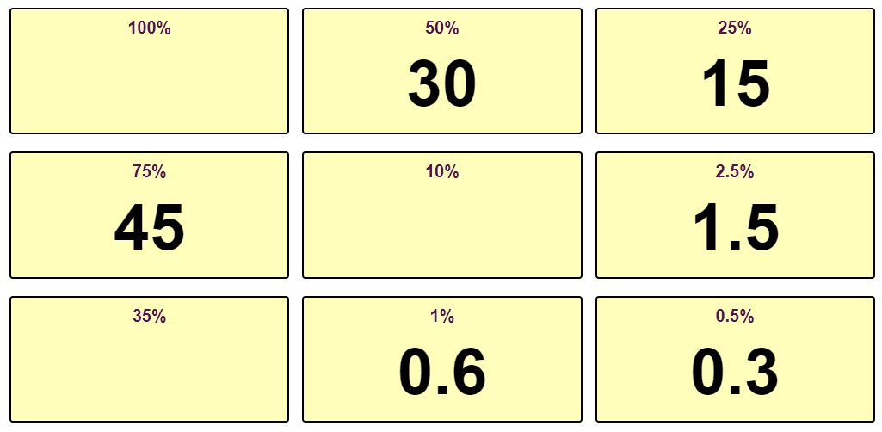
Knowing how to calculate % dividing by 10, 100, doubling and halving

Slide 10
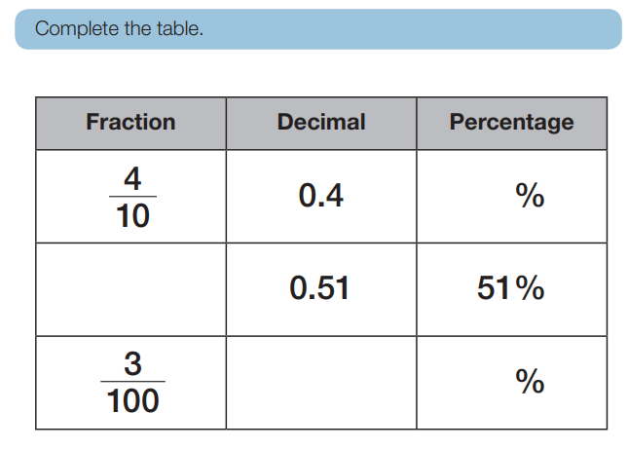
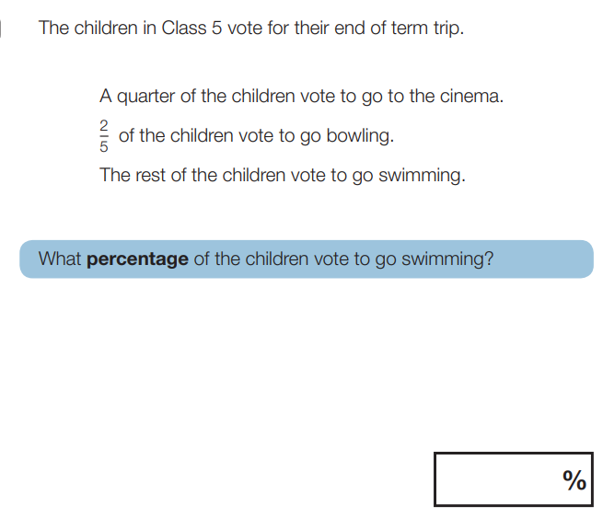
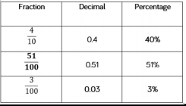
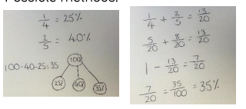
35

