Slide 1
Describing
This is in the context of measurement, cm and m
Sophie says,
“50 cm is greater than 1 m.”
Is she correct? Explain your reasoning.
The numbers I need to use are 50 and 1.

Slide 2
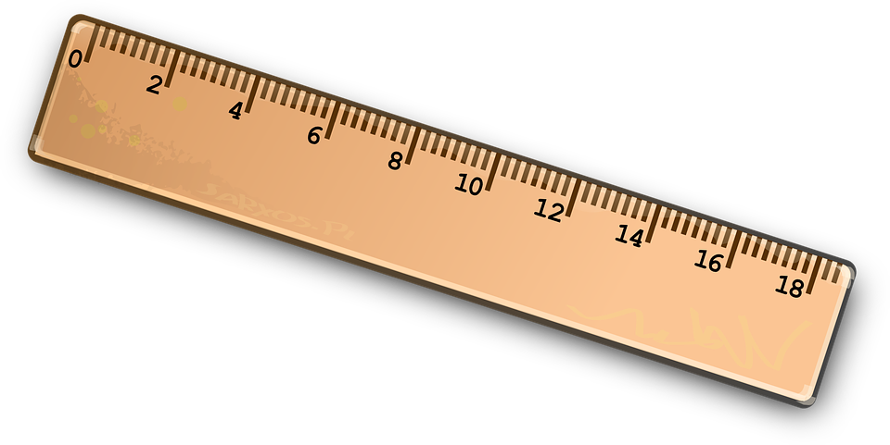
Explaining
The measurements are different units because one is given in cm the other in m
Sophie says,
“50 cm is greater than 1 m.”
Is she correct? Explain your reasoning.
It is true that I will need to make both units of measurement the same for comparison
Recall of knowledge

Slide 3
Convincing
The measurements are different units. I am convinced that cm are smaller than m.
Sophie says,
“50 cm is greater than 1 m.”
Is she correct? Explain your reasoning.
I can prove that there are 100cm in a m.
Recall of knowledge, 100cm = 1m

Slide 4
Justifying
100 cm = 1 m
50 = $\frac{1}{2}$ m
Sophie says,
“50 cm is greater than 1 m.”
Is she correct? Explain your reasoning.
Model of proof
50cm
1m

Slide 5
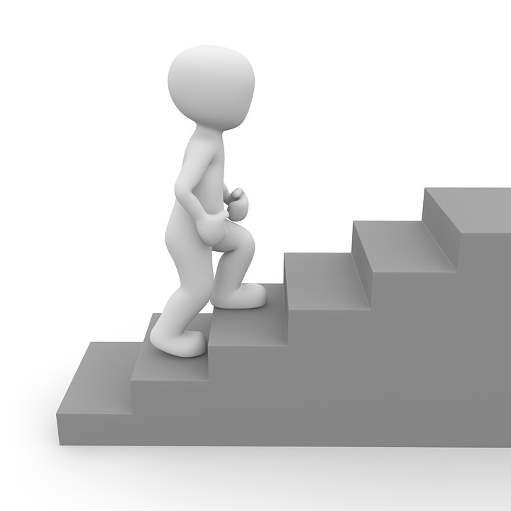
Expert
50cm is shorter than 100cm, which is equal to 1m.
Specialising
Examples that satisfy the statement
64 cm > $\frac{1}{2} m$ = 64 cm > 50 cm
78 cm < 1 m = 78 cm < 100 cm
105 cm > 1 m = 105 cm > 100 cm
Sophie says,
“50 cm is greater than 1 m.”
Is she correct? Explain your reasoning.
To compare any measurements given in different units must be converted to the same unit.
50cm
100cm
Generalising

Slide 6
Conjecturing
All measurements convert from the larger unit to the smaller unit in order to compare them.
Conjecturing: reasoning about mathematical relationships to develop statements that are tentatively thought to be true but are not known to be true (Lannin, Ellis & Elliott, 2011)

Slide 7
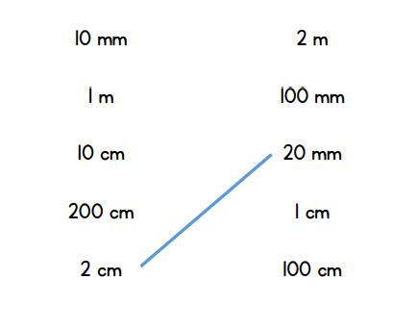
All measurements convert from the larger unit to the smaller unit in order to compare them.
Offering proof that it is sometimes true
Matching the equivalent measurements
70
100cm
160mm
7 cm
Write the lengths in order of size starting with the shortest.
Offering proof that it is true

Slide 8
