Slide 1
Describing
It is about $\frac{1}{2} and\frac{1}{4}$
Fractions of shape

Slide 2
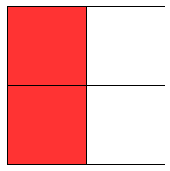
Explaining
This is the same because the shaded areas will be equal
It is true that shapes can show $\frac{1}{2}$ as one of 2 equal parts

Slide 3
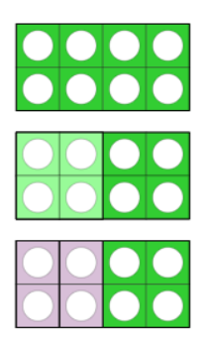
Convincing
I am convinced that $\frac{1}{2}is equal to\frac{2}{4}$
1
$$\frac{1}{2}$$
I can prove that $\frac{1}{2}=\frac{2}{4}$
when the whole one is the same.
$$\frac{1}{4}$$
$$\frac{1}{4}$$

Slide 4
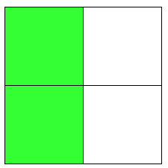
Justifying
$$\frac{1}{2}=\frac{2}{4}$$

Slide 5
Expert
Specialising
1 whole = two halves
1 whole = four quarters
Examples that satisfy the statement
$$\frac{1}{2} of 4=2$$
$$\frac{2}{4} of 4=2$$
$$\frac{1}{2} of 12=6$$
$$\frac{2}{4}of 12=6$$
Equivalent fractions are the same size, when compared with the same whole.
Generalising

Slide 6
Ben eats $\frac{1}{2}$of the chocolate bar.
Sita eats $\frac{2}{4}$ of the same chocolate bar.
Ben says “ That is not fair, Sita has had more than me.”
Show Ben that he is not correct.

Slide 7
Ben eats $\frac{1}{2}$of the sweets.
Sita eats $\frac{1}{4}$ of the sweets.
Ben says “ That is not fair, Sita has had more than me as $\frac{1}{4}$ is larger than $\frac{1}{2}$.”
Show Ben that he is not correct.

