Slide 1
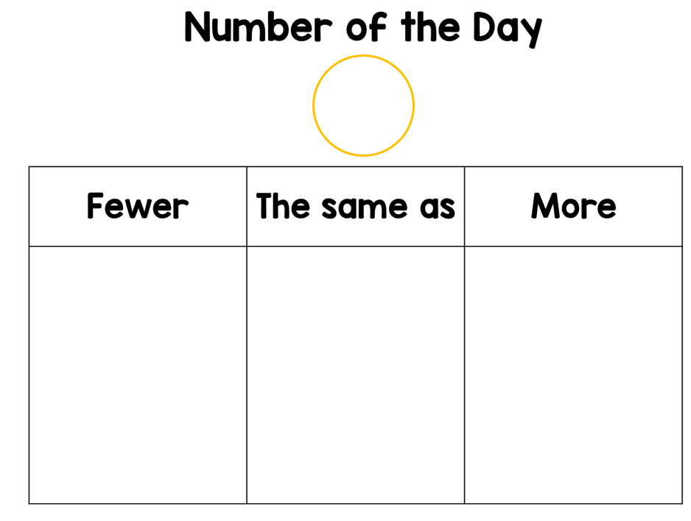
Describing
6

Slide 2
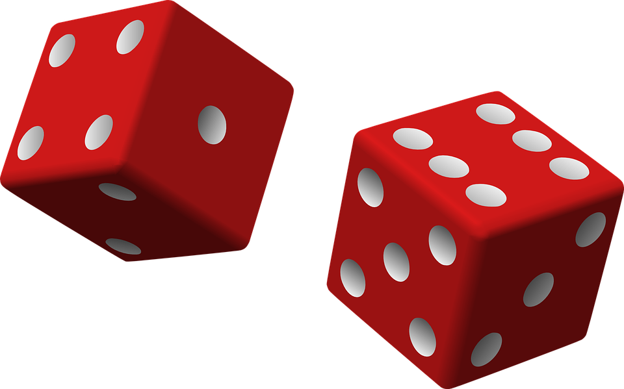
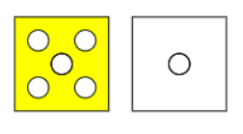
“If I roll a 5 then a 1 on my dice, I will have rolled 6 altogether.”

Slide 3
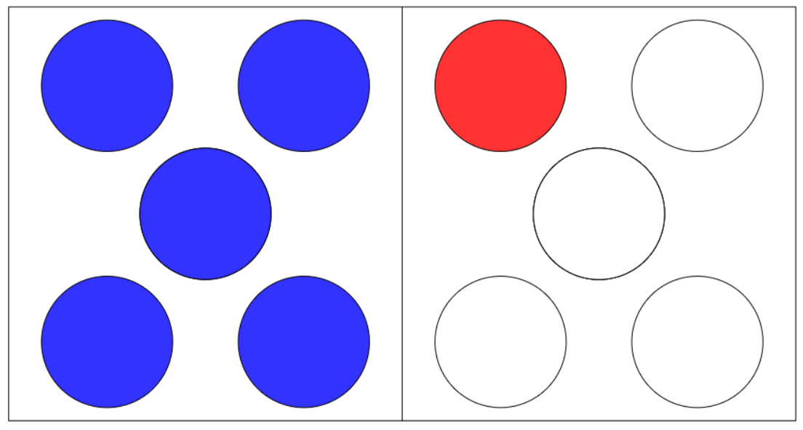
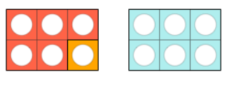
Explaining
This is 6 because 5 and one more equals 6
It is true that
5 + 1 = 6
=

Slide 4
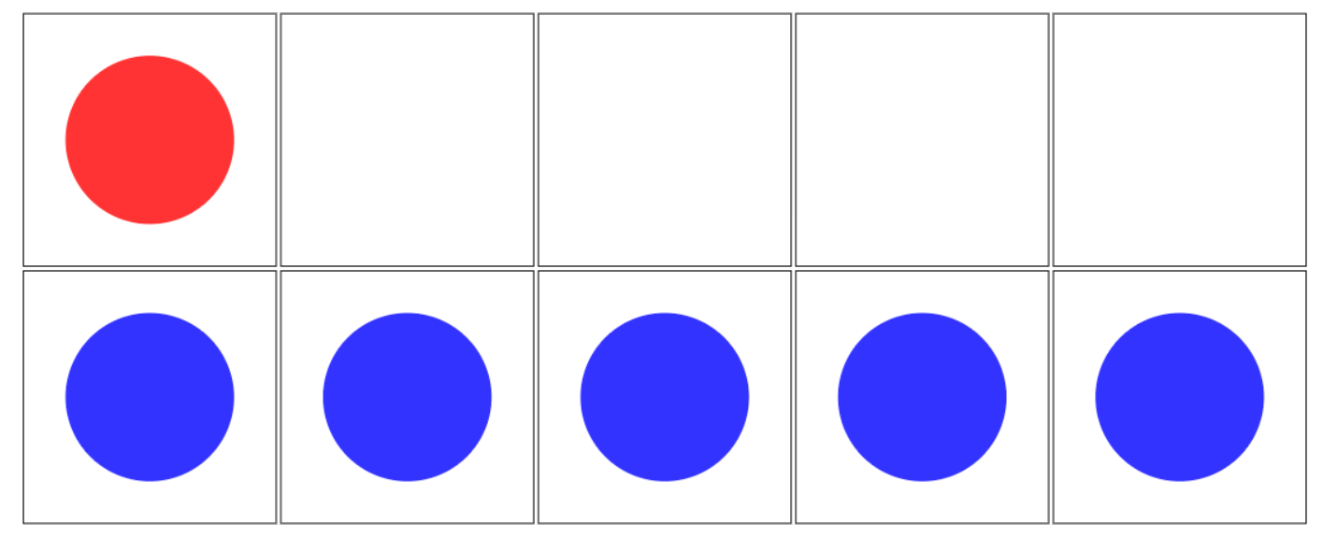
Convincing
I am convinced this is 6.
I can prove that this is also 6.
1 + 5 = 6

Slide 5
Justifying
5 + 1 = 6
1 + 5 = 6.
I can roll a 5 then a 1 or 1 then a 5 to make 6

Slide 6
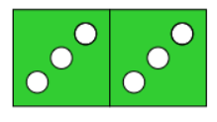
Expert
Specialising
3 + 3 = 6
Examples that satisfy the statement
1 + 5 = 6
5 + 1 = 6
3 + 3 = 6
When adding you can change the order.
Generalising

Slide 7
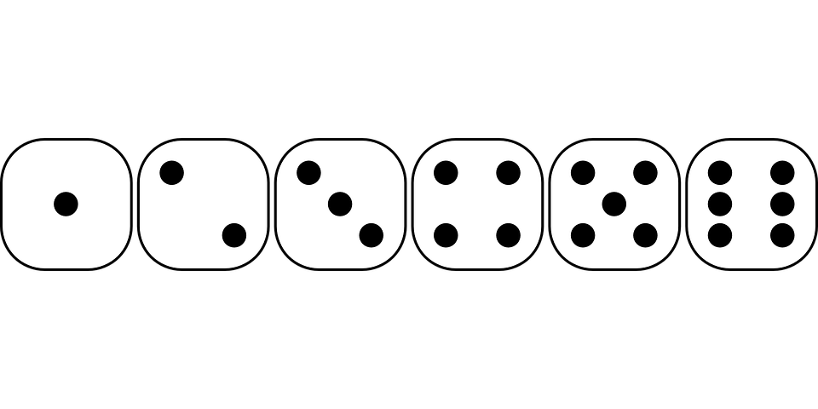
“What other ways are there to roll 6 with 2 dice ?”

